Slide 1

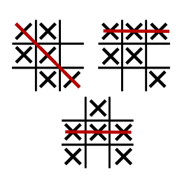
Tic-Tac-Toe
Classic 3 by 3 X and O grid game
By: Tobin Massie
https://github.com/ksu-is/Tic-Tac-Toe-V

